Slide 1
CTRL + ALT + DEL (Phase 1 PPT)

Slide 2
agenda
DATASET 3
CORRELATION HEATMAP 4
RANDOM FOREST CLASSIFIER 5
SMOTE ANALYSIS 6
K-MEANS CLUSTERING 7
ONE CLASS SVM 8

Slide 3
SAMPLE DATASET
timestamp,cpu_usage,memory_usage,network_io,pod_status2024-01-01 00:00:00,39.963209507789,1562.5501378250951,26.90886268985469,02024-01-01 01:00:00,86.05714451279329,4381.017484289029,25.450901108127983,02024-01-01 02:00:00,68.5595153449124,6996.272103423626,90.71920347158263,02024-01-01 03:00:00,57.89267873576293,5884.576602635533,25.705073785101103,02024-01-01 04:00:00,22.48149123539492,6471.833068105453,27.92302288673447,02024-01-01 05:00:00,22.479561626896214,5304.3885970146675,76.18042797937841,02024-01-01 06:00:00,14.646688973455957,5568.984859691034,45.52424440260346,12024-01-01 07:00:00,79.29409166199481,6808.645647366023,77.89434513856294,02024-01-01 08:00:00,58.0892009394567,2072.377269987569,7.471249598874139,02024-01-01 09:00:00,66.64580622368364,3966.4572127808096,49.269548173665044,02024-01-01 10:00:00,11.646759543664196,1847.5545903748575,4.327746418144981,02024-01-01 11:00:00,87.59278817295954,7902.577263173512,7.202667142080098,02024-01-01 12:00:00,76.59541126403374,7558.068783524245,90.73730788109668,02024-01-01 13:00:00,26.987128854262092,411.4718098111966,14.78529174064192,02024-01-01 14:00:00,24.54599737656805,5674.043862873938,53.70964754524649,02024-01-01 15:00:00,24.672360788274705,7409.46170758376,41.69846465746995,02024-01-01 16:00:00,34.33937943676302,1526.5452265059348,35.38698929962543,02024-01-01

Slide 4
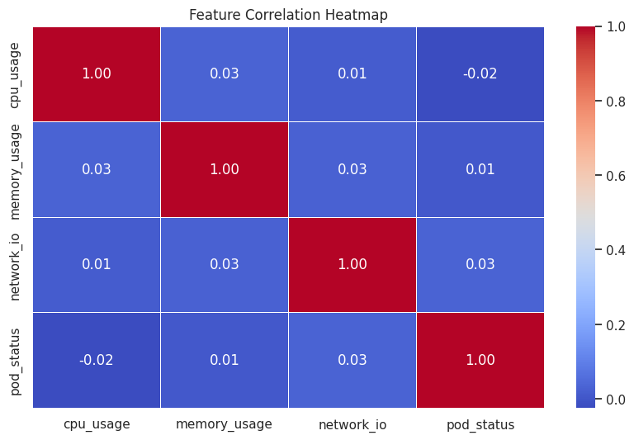
CORRELATION HEATMAP
# Exclude non-numeric columns
df_numeric =
df.select_dtypes(include=['number’])
# Compute correlation matrix
correlation_matrix = df_numeric.corr()
# Plot heatmap
import seaborn as sns
import matplotlib.pyplot as plt
plt.figure(figsize=(10, 6))
sns.heatmap(correlation_matrix, annot=True,
cmap="coolwarm", fmt=".2f", linewidths=0.5)
plt.title("Feature Correlation Heatmap")
plt.show()

Slide 5
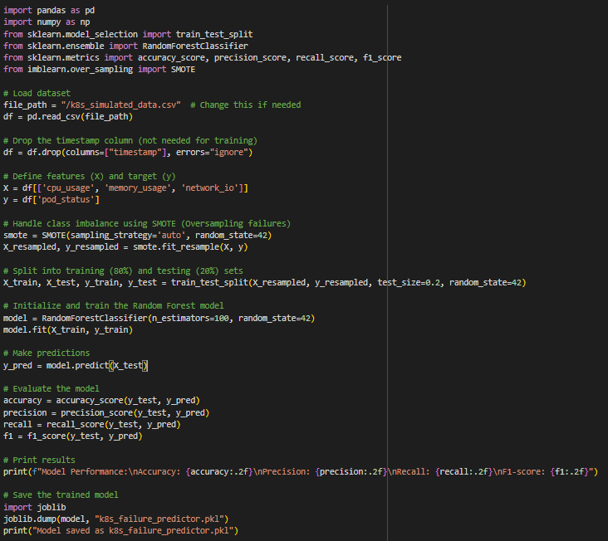

RANDOM FOREST CLASSIFIER

Slide 6
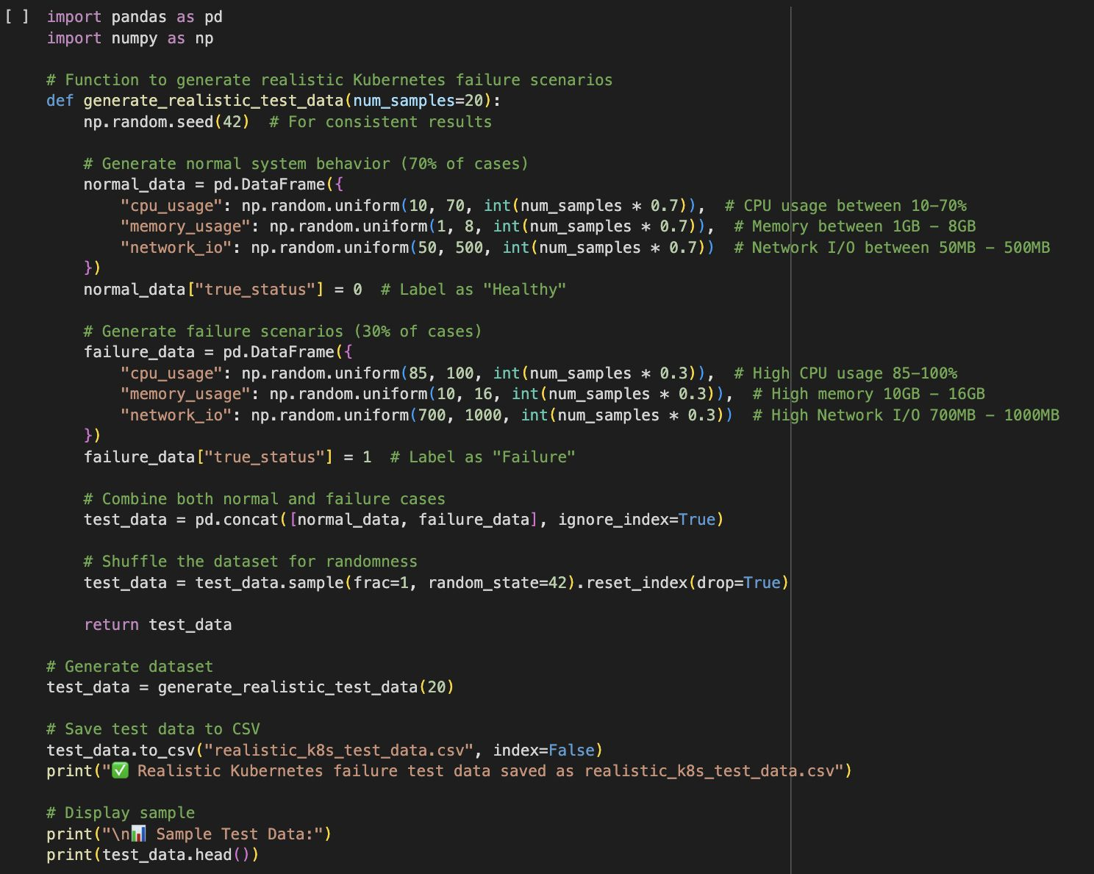
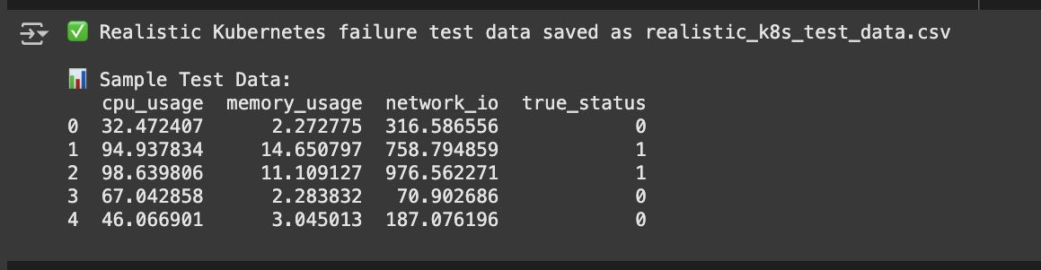
SMOTE ANALYSIS

Slide 7
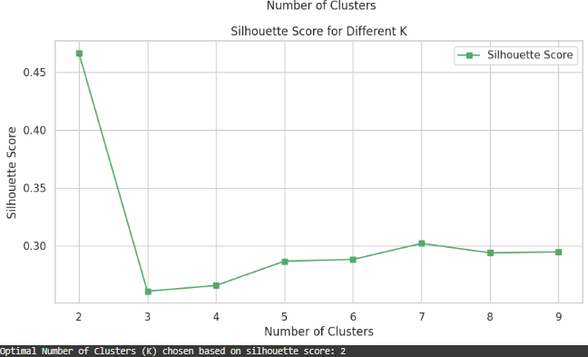
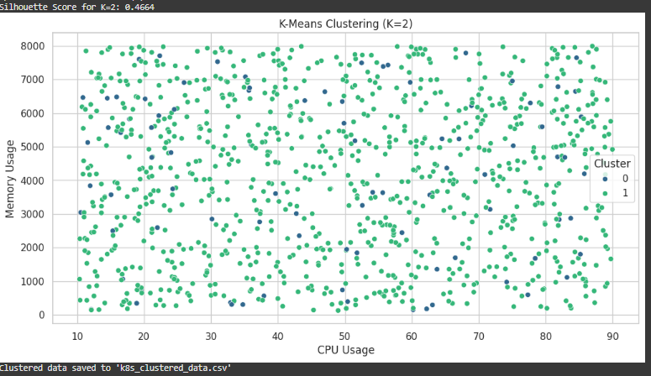
K-MEANS CLUSTERING

Slide 8
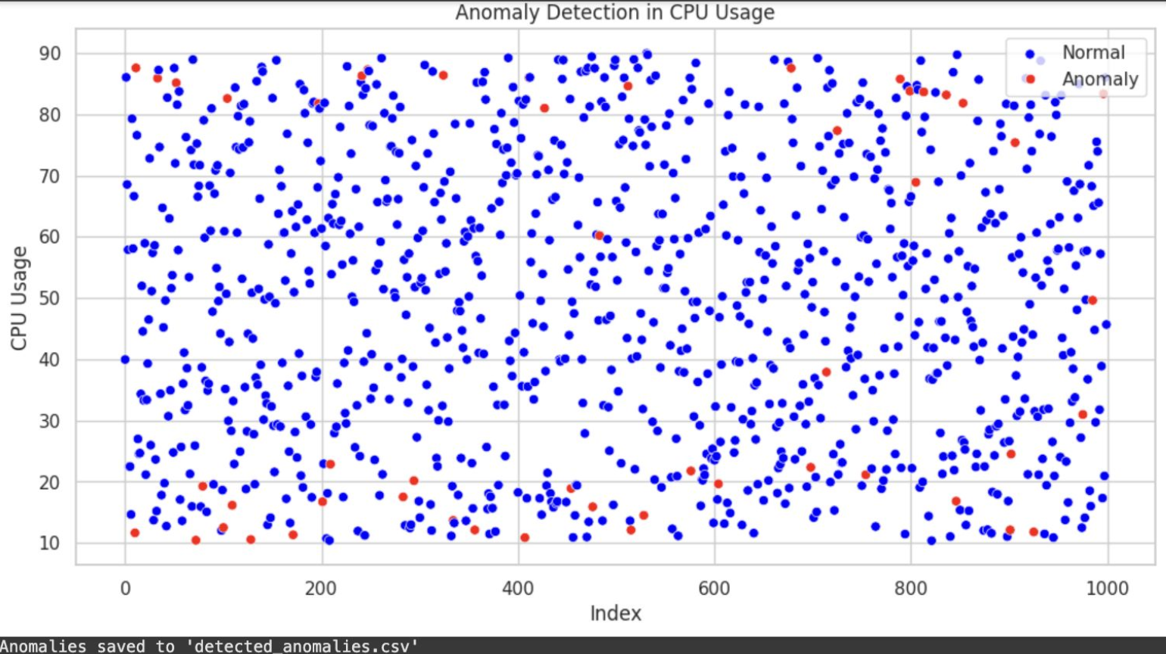
ONE CLASS SVM

Slide 9
Thank you

